Slide 1

Parent feedback on nurture rooms and resourced provisions
Purpose: share themes and agree questions for LA response
Findings from parent feedback across mainstream schools
Focus on lived experience, inclusion and outcomes

Slide 2
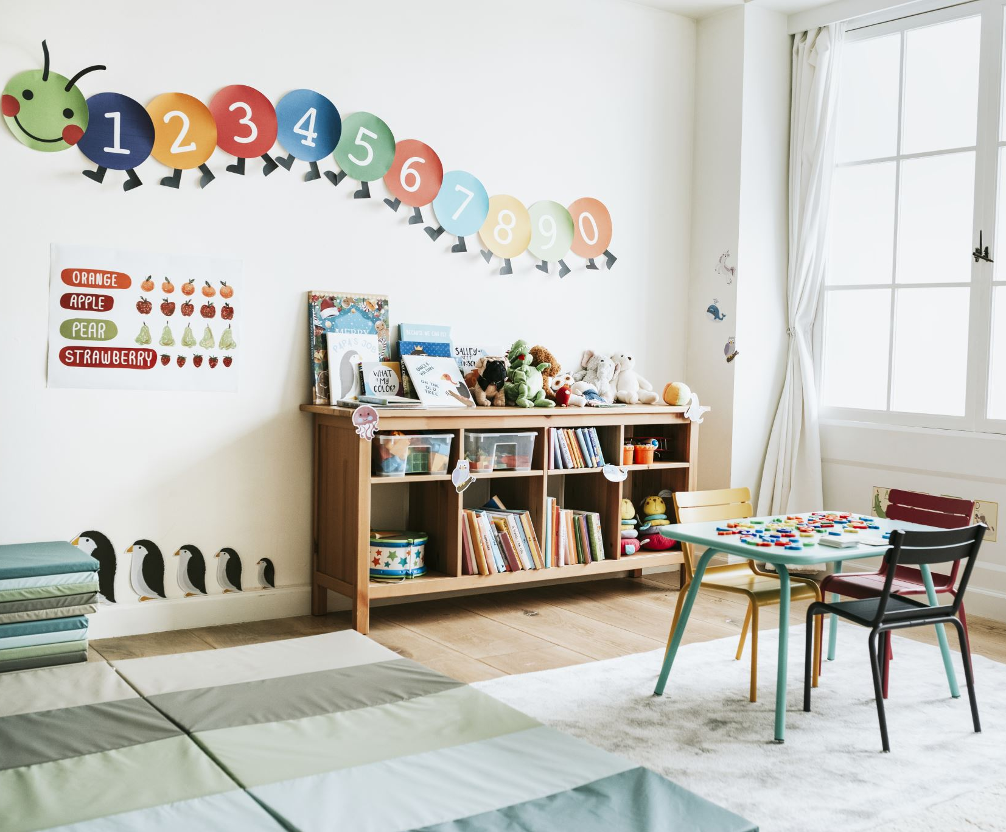
What parents understand nurture rooms to be
Intended as short-term emotional support
A calm space to help children regulate
Purpose and expectations often unclear
Some parents unaware the nurture room existed

Slide 3
What parents say works
Short-term emotional safety
Children feel calmer during dysregulation
Positive relationships with individual staff
“Usually my child gets better there and is relaxed.”

Slide 4
Main concern: overuse and drift
Frequent or daily use reported
Becomes default response rather than targeted support
Limited review points or exit planning
“Children spend far too much time in it (over 50%).”

Slide 5
Impact on learning and inclusion
Reduced access to classroom learning
01
Increased separation from peers
02
Loss of friendships and social opportunities
03
“He didn’t have many friends because he was in that small room most of the time.”
04

Slide 6
When nurture rooms become long-term
Temporary support becoming permanent
Children losing confidence to return to class
Described by parents as internal or ‘soft’ exclusion
“He has now been out of class for a year.”

Slide 7
Staffing and quality concerns
Limited specialist training reported
Reliance on unqualified or unsupported staff
Parents feel learning can be overlooked
“The children who need it the most are working with the least qualified staff.”

Slide 8
Resourced provisions: parent concerns
Limited mainstream inclusion in practice
Some children educated separately full time
Risk of containment rather than bridge provision
“Not inclusive. Kids are in there full time.”

Slide 9
Key messages from parents
Nurture rooms can help in the short term
Overuse and lack of clarity are major concerns
Learning and inclusion can be compromised
Review, oversight and accountability are needed

Slide 10
Questions for Local Authority response
How is the purpose of nurture rooms defined and communicated?
What oversight exists on frequency and duration of use?
How is inclusion and curriculum access assured?
What expectations exist around review and exit planning?
How are parents informed and involved?
How is staffing quality and training assured?
How is inclusion monitored in resourced provisions?
How is drift used to compensate for gaps prevented?

